Slide 1
XSL
(eXtensible Stylesheet
Language)
U. K. Roy

Slide 2
Transformation
Source document
<para>
XSLT is <em>powerful<em>.
</para>
Transformation
<html>
<head><title></title></head>
<body>
<p>
XSLT is <b>powerful</b>.
</p>
</body>
<html>
Target document

Slide 3
Transformation
<company>
<employee>
<name>S. K. Pal</name>
<phone>25735621</phone>
<dob>1975-04-03</dob>
<salary>25000</salary>
<acc-no>001452345543</acc-no>
</employee>
</company>
Source document
Transformation
<company>
<employee>
<name>S. K. Pal</name>
<phone>25735621</phone>
</employee>
</company>
Target document

Slide 4
Reformatting
<employee>
<name>K. Pal</name>
<sex>male</sex>
<status>single</status>
<salary basic='1500' DA='1000'/>
</employee>
Source document
Reformatting
<employee profile='male single'>
<name>K. Pal</name>
<salary>
<basic>1500</basic>
<DA>1000</DA>
</salary>
</employee>
Target document

Slide 5
Java program
Translate.java

Slide 6
Problem
Almost not readable
Any changes in the source XML document would require significant change in the Java source code and need recompilation

Slide 7
XSLT solution
<?xml version='1.0'?>
<xsl:transform version='2.0' xmlns:xsl='http://www.w3.org/1999/XSL/Transform'>
<xsl:template match='/employee'>
<xsl:element name='employee'>
<xsl:attribute name='profile' select='concat(status, " ", sex)' />
<name><xsl:value-of select='name' /></name>
<salary>
<basic><xsl:value-of select='salary/@basic' /></basic>
<DA><xsl:value-of select='salary/@DA' /></DA>
</salary>
</xsl:element>
</xsl:template>
</xsl:transform>

Slide 8
XSLT solution
Source document
Target document
<?xml version='1.0'?>
<employee>
<name>K. Pal</name>
<sex>male</sex>
<status>single</status>
<salary basic='1500' DA='1000'/>
</employee>
<?xml version='1.0'?>
<employee profile='male single'>
<name>K. Pal</name>
<salary>
<basic>1500</basic>
<DA>1000</DA>
</salary>
</employee>
<?xml version='1.0'?>
<xsl:transform version='2.0' xmlns:xsl='http://www.w3.org/1999/XSL/Transform'>
<xsl:template match='/employee'>
<xsl:element name='employee'>
<xsl:attribute name='profile' select='concat(status, " ", sex)' />
<name><xsl:value-of select='name' /></name>
<salary>
<basic><xsl:value-of select='salary/@basic' /></basic>
<DA><xsl:value-of select='salary/@DA' /></DA>
</salary>
</xsl:element>
</xsl:template>
</xsl:transform>
XSLT document

Slide 9
Advantage
Smaller in size
Redable

Slide 10
Role of XSLT
HTML
XML
XSLT
XML
CSS
Presentation
Document
XSL-FO
CSS

Slide 11
Stylesheet structure
XSLT files are themselves XML file
http://www.w3.org/2005/02/schema-for-xslt20.xsd

Slide 12
Stylesheet structure
Root element
<xsl:stylesheet version='2.0' xmlns:xsl='http://www.w3.org/1999/XSL/Transform'>
…
</xsl:stylesheet>
<xsl:transform version='2.0' xmlns:xsl='http://www.w3.org/1999/XSL/Transform'>
…
</xsl:transform>

Slide 13
Using XSLT documents
Add a link in XML document to point XSLT file
<?xml version='1.0' ?>
<?xml-stylesheet type='text/xsl' href='AnXSLTFile.xsl'?>
<root>
…
</root>

Slide 14
Using XSLT documents
More often browsers do not support XSLT 2.0 which provides better functionality
Process further instead of display
Use XSLT processors to get the desired result

Slide 15
XSLT elements
analyze-string | apply-imports | apply-templates | attribute | attribute-set
call-template | character-map | choose | comment | copy
copy-of | decimal-format | element | fallback | for-each
for-each-group | function | if | import | import-schema
include | key | message | namespace-alias | number
otherwise | output | p | perform-sort | preserve-space
processing-instruction | result-document | sort | strip-space | stylesheet
template | text | transform | value-of | variable
when | with-param
Non-XSLT elements are just added to the output

Slide 16
XSLT templetes
It is all about template rules
A template specifies a rule and an instruction, which is executed when the rule matches
<xsl:template match='XPath expression'>
Instruction to be followed
</xsl:template>

Slide 17
XSLT templates
It is all about template rules
A template specifies a rule and an instruction, which is executed when the rule matches
<xsl:template match='XPath expression'>
Instruction to be followed
</xsl:template>

Slide 18
An example
<?xml version='1.0' ?>
<xsl:transform version='2.0' xmlns:xsl='http://www.w3.org/1999/XSL/Transform' >
<xsl:output method='html' />
<xsl:template match='/'>
Hello world!
</xsl:template>
</xsl:transform>
Result
  Hello world

Slide 19
Another example
<?xml version='1.0' ?>
<xsl:transform version='2.0' xmlns:xsl='http://www.w3.org/1999/XSL/Transform' >
<xsl:template match='/‘>
<html>
<head><title>Simple template</title></head>
<body>
<h1>Hello world!</h1>
</body>
</html>
</xsl:template>
</xsl:transform>

Slide 20
Result
<html>
<head><title>Simple template</title></head>
<body>
<h1>Hello world!</h1>
</body>
</html>

Slide 21
XSL
XSL = eXtensible Stylesheet Language
XSL consists of
  XPath (navigation in documents)
  XSLT (T for transformations)
  XSLFO (FO for formatting objects)
    This is a rather complex language for typesetting (i.e., preparing text for printing)

Slide 22
<?xml version="1.0" encoding="ISO-8859-1"?>
<catalog>
<cd country="UK">
<title>Dark Side of the Moon</title>
<artist>Pink Floyd</artist>
<price>10.90</price>
</cd>
<cd country="UK">
<title>Space Oddity</title>
<artist>David Bowie</artist>
<price>9.90</price>
</cd>
<cd country="USA">
<title>Aretha: Lady Soul</title>
<artist>Aretha Franklin</artist>
<price>9.90</price>
</cd>
</catalog>
An XML document

Slide 23
Today - Focus on Generating HTML/XML
XML
(content)
XSL
(presentation)
XSL
Processor
HTML/XML

Slide 24
XSL Stylesheet
An XSL stylesheet is a program that transforms an XML document into another XML document
For example:
  Transforming XML to XHTML (HTML that conforms to XML syntax)
  Transforming an XML document to WML (a format of XML that cellular phones can display)

Slide 25
A Few Things About XSL
XSL is a high-level, functional language
An XSL style sheet is a valid XML document
  Valid with respect to the XSL namespace
Therefore, commands in XSL are XSL elements

Slide 26
The Root of the XSL Document
The Root of the XSL document should be one of the following lines:
<xsl:stylesheet version="1.0"
xmlns:xsl="http://www.w3.org/1999/XSL/Transform">
<xsl:transform version="1.0"
xmlns:xsl="http://www.w3.org/1999/XSL/Transform">
The namespace allows the XSL processor to distinguish
between XSL tags and tags of the result document

Slide 27
Applying XSLT Stylesheets to
XML Documents
There are three ways of applying an XSLT stylesheet to an XML document
  Adding to the XML document a link to the XSL stylesheet and letting the browser do the transformation
  Directly applying an XSLT processor to the XML document and the XSLT stylesheet
  Calling an XSLT processor from within a (JSP) program

Slide 28
Letting a Browser Perform the Transformation
<?xml version="1.0" encoding="ISO-8859-1"?>
<?xml-stylesheet type="text/xsl"
href=“catalog.xsl"?>
<catalog>
<cd country="UK">
<title>Dark Side of the Moon</title>
<artist>Pink Floyd</artist>
<price>10.90</price>
</cd>
…
</catalog>
A link to the stylesheet

Slide 29
Using an XSL Processor
XSL
stylesheet
XML
document
Result is
either an
XML, HTML
or text
document
XSL Processor
java Transform
myXmlFile.xml myXslFile.xsl
Directly applying the Java XSL processor

Slide 30
Server side Transformation
<%
TransformerFactory factory =
TransformerFactory.newInstance();
Transformer transformer = factory.newTransformer(
new StreamSource("cdcatalog.xsl"));
transformer.transform(new StreamSource
("cdcatalog.xml"), new StreamResult(out));
%>

Slide 31
XSL - all about (Template) “Rules”
“Hey xsl processor, when you encounter the root element (e.g., BookCatalogue) do [action1]”
“Hey xsl processor, when you encounter the Book element do [action2]”
“Hey xsl processor, when you encounter the Title element do [action3]”
And so forth

Slide 32
XSL - all about (Template) “Rules”
Each template rule has two parts:
  A pattern or matching part, that identifies the XML node in the source document to which the action part is to be applied. Matching information is contained in an attribute.
  An action or formatting, styling and processing part that details the transformation and styling of the resulting node

Slide 33
XSL Document Structure
xsl:stylesheet
template rule for the
document
(template rule for a child element)*
action on the child element
action on the
document

Slide 34
XSL Document Structure
<?xml version=“1.0”?>
<xsl:stylesheet>
<xsl:template match=“/”>
[action]
</xsl:template>
<xsl:template match=“BookCatalogue”>
[action]
</xsl:template>
<xsl:template match=“Book”>
[action]
</xsl:template>
...
</xsl:stylesheet>

Slide 35
How Does XSLT Work?
An XSL stylesheet is a collection of templates that are applied to source nodes (i.e., nodes of the given XML document)
Each template has a match attribute that specifies to which source nodes the template can be applied
The current source node is processed by applying a template that matches this node
Processing always starts at the root (/)

Slide 36
Templates
A template has the form
  <xsl:template match="pattern">
  ...
  </xsl:template>
The content of a template consists of
  XML elements and text that are copied to the result
  XSL elements that are actually instructions
The pattern syntax is a subset of XPath

Slide 37
<?xml version="1.0" encoding="ISO-8859-1"?>
<xsl:stylesheet version="1.0"
xmlns:xsl="http://www.w3.org/1999/XSL/
Transform">
<xsl:template match="/">
<html>
<body>
<h1>Hello World</h1>
</body>
</html>
</xsl:template>
</xsl:stylesheet>

Slide 38
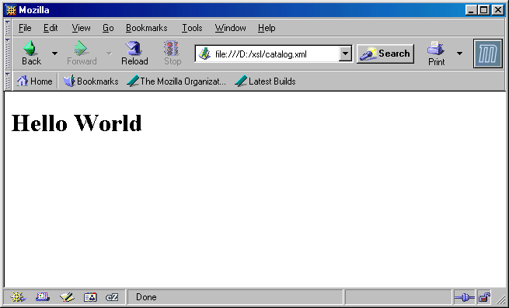
<html>
<body>
<h1>Hello World</h1>
</body>
</html>
Applying a browser to catalog.xml
(catalog.xml has a link to catalog.xsl)

Slide 39
The Element
<xsl:apply-templates>
Processing starts by applying a template that matches the root (/)
  If the given XSL stylesheet does not have a template that matches the root, then one is inserted by default (see the slide on “Default Templates”)
The XSL stylesheet must specify explicitly whether templates should be applied to descendants of the root
It is done by putting inside a template the instruction:
<xsl:apply-templates select="xpath"/>
Without the select attribute, this instruction processes all the children of the current node

Slide 40
Template Rules (Example)
<xsl:template match=“cd”>
<xsl:apply-templates/>
</xsl:template>
<xsl:template match=“cd”>
“Hey XSL processor, as you parse through the XML document
and you get to a <cd> element use this template rule.”
<xsl:apply-templates/>
“Go to each of my children and apply the template rules to them.”

Slide 41
<?xml version="1.0" encoding="ISO-8859-1"?>
<xsl:stylesheet version="1.0"
xmlns:xsl="http://www.w3.org/1999/XSL/Transform">
<xsl:template match="/">
<html>
<body>
<xsl:apply-templates select="catalog/cd"/>
</body>
</html>
</xsl:template>
<xsl:template match="cd">
<h2>A CD!</h2>
</xsl:template>
</xsl:stylesheet>
<html>
<body>
<h2>A CD!</h2>
<h2>A CD!</h2>
<h2>A CD!</h2>
</body>
</html>

Slide 42
Default Templates
XSL provides implicit built-in templates that match every element and text nodes
Templates we write always override these built-in templates (when they match)
<xsl:template match=“*”>
<xsl:apply-templates/>
</xsl:template>
<xsl:template match=“text()”>
<xsl:value-of select=“.”/>
</xsl:template>

Slide 43
The Most Frequently Used Elements of XSL
<xsl:value-of select=“xpath-expression”/>
  This element extracts the value of a node from the nodelist located by xpath-expression
<xsl:for-each select=“xpath-expression”/>
  This element loops over all the nodes in the nodelist located by xpath-expression
<xsl:if test=“xpath-expression”/>, <xsl:if test=“xpath-expression=value”/>, etc.
  This element is for conditional processing

Slide 44
The <xsl:value-of> Element
<xsl:value-of select=“xpath-expression”/>
The XSL element <xsl:value-of> can be used to extract the value of an element that is selected from the source XML document
The extracted value is added to the output stream
The selected element is located by an XPath expression that appears as the value of the select attribute

Slide 45
Explanation
<xsl:template match=“text()”>
<xsl:value-of select="."/>
</xsl:template>
“Hey XSL processor, return the value of the thing that is selected
here” In our example the “thing” that is selected is a text node, so the
“thing” that is returned is the value of the text node, i.e., the text.

Slide 46
<?xml version="1.0" encoding="ISO-8859-1"?>
<xsl:stylesheet version="1.0"
xmlns:xsl="http://www.w3.org/1999/XSL/
Transform">
<xsl:template match="/">
<html>
<body>
<h2>A CD Catalog</h2>
<table border="1">
<tr bgcolor=“yellow">
<th>Title</th>
<th>Artist</th>
</tr>

Slide 47
<tr>
<td><xsl:value-of
select="catalog/cd/title"/>
</td>
<td><xsl:value-of
select="catalog/cd/artist"/>
</td>
</tr>
</table>
</body>
</html>
</xsl:template>
</xsl:stylesheet>
Note that only the first matched
element is retrieved for each
<xsl:value of>

Slide 48
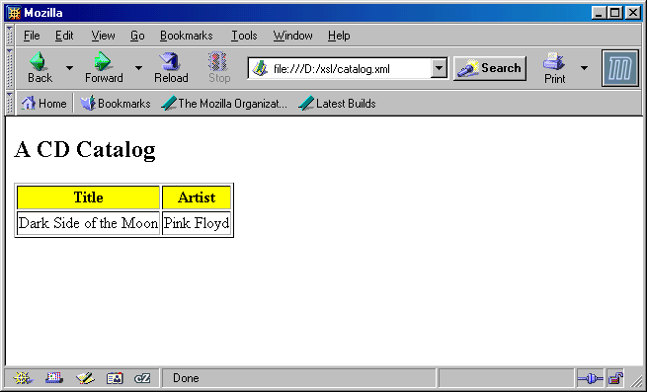
Selected values

Slide 49
The <xsl:for-each> Element
The <xsl:for-each> element loops over all the nodes in the nodelist of the XPath expression that appears as the value of the select attribute
The value of each node can be extracted by an <xsl:value-of> element
<xsl:for-each select=“xpath-expression”/>

Slide 50
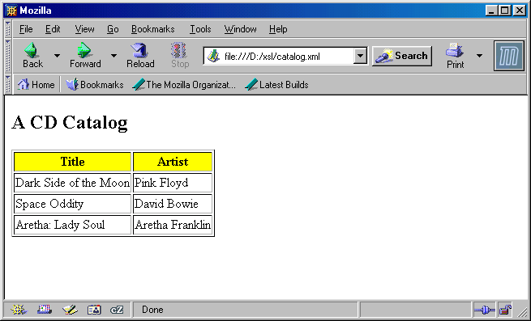
All the values are selected

Slide 51
<?xml version="1.0" encoding="ISO-8859-1"?>
<xsl:stylesheet version="1.0"
xmlns:xsl="http://www.w3.org/1999/XSL/
Transform">
<xsl:template match="/">
<html>
<body>
<h2>A CD Catalog</h2>
<table border="1">
<tr bgcolor=“yellow">
<th>Title</th>
<th>Artist</th>
</tr>
As in the
previous
example

Slide 52
<xsl:for-each select="catalog/cd">
<tr>
<td><xsl:value-of select="title"/>
</td>
<td><xsl:value-of select="artist"/>
</td>
</tr>
</xsl:for-each>
</table>
</body>
</html>
</xsl:template>
</xsl:stylesheet>
Note that all the /catalog/cd
elements are retrieved

Slide 53
Consider the following change in the select attribute:
<xsl:for-each
select="catalog/cd[price&lt;10]">
<tr>
<td><xsl:value-of select="title"/>
</td>
<td><xsl:value-of select="artist"/>
</td>
</tr>
</xsl:for-each>
</table>
</body>
</html>
</xsl:template>
</xsl:stylesheet>
Only elements that satisfy
/catalog/cd[price<10]
are retrieved

Slide 54
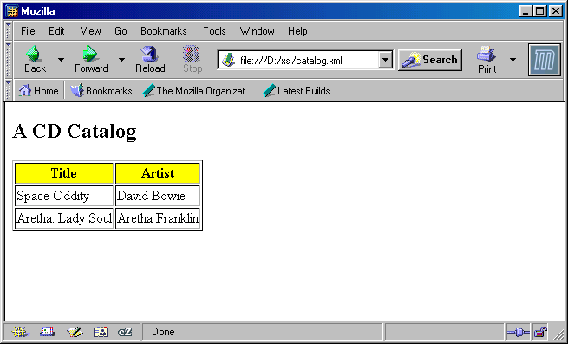

Slide 55
The <xsl:sort> Element
The <xsl:sort> element is used to sort the list of nodes that are looped over by the <xsl:for-each> element
Thus, the <xsl:sort> must appear inside the <xsl:for-each> element
The looping is done in sorted order

Slide 56
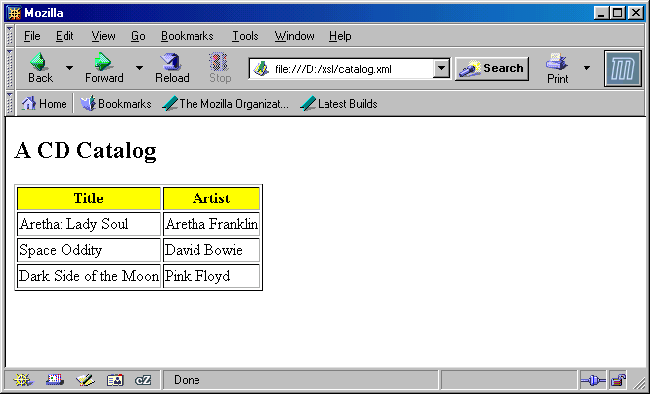
Sorted by the name of the artist

Slide 57
<xsl:for-each select="catalog/cd">
<xsl:sort select="artist"/>
<tr>
<td><xsl:value-of select="title"/>
</td>
<td><xsl:value-of select="artist"/>
</td>
</tr>
</xsl:for-each>
</table>
</body>
</html>
</xsl:template>
</xsl:stylesheet>
The /catalog/cd elements
are sorted according to the
value of the artist element

Slide 58
The <xsl:if> Element
The <xsl:if> element is used for conditional processing
The condition appears as the value of the test attribute, for example:
<xsl:if test="price &gt; 10">
some output ...
</xsl:if>
The elements inside the <xsl:if> element are processed if the condition is true

Slide 59
Note
Processing the inside elements means
  Copying them into the output stream if they are not XSL elements, and
  Evaluating them if they are XSL elements
If the value of the test attribute is just an XPath expression (i.e., without any comparison), then the test is satisfied if the nodelist of this XPath expression is not empty

Slide 60
<?xml version="1.0" encoding="ISO-8859-1"?>
<xsl:stylesheet version="1.0"
xmlns:xsl="http://www.w3.org/1999/XSL/
Transform">
<xsl:template match="/">
<html>
<body>
<h2>A CD Catalog</h2>
<table border="1">
<tr bgcolor=“yellow">
<th>Title</th>
<th>Artist</th>
</tr>
As in the
previous
examples

Slide 61
<xsl:for-each select="catalog/cd">
<xsl:if test="price &gt; 10">
<tr>
<td><xsl:value-of select="title"/>
</td>
<td><xsl:value-of select="artist"/>
</td>
</tr>
</xsl:if>
</xsl:for-each>
</table>
</body>
</html>
</xsl:template>
</xsl:stylesheet>
Only /catalog/cd with
price>10 are retrieved

Slide 63
The <xsl:choose> Element
The <xsl:choose> element is used in conjunction with <xsl:when> and <xsl:otherwise> to express test with multiple conditions
There can be many <xsl:when> inside an <xsl:choose> element, but there should be a single <xsl:otherwise> inside an <xsl:choose> element

Slide 64
Using <xsl:choose>
To insert a conditional choose against the content of the XML file, simply add the <xsl:choose>, <xsl:when>, and <xsl:otherwise> elements to your XSL document like this:
<xsl:choose>
<xsl:when test="price &gt; 10">
... some code ...
</xsl:when>
<xsl:otherwise>
... some code ....
</xsl:otherwise>
</xsl:choose>

Slide 65
<xsl:for-each select="catalog/cd"><tr>
<td><xsl:value-of select="title"/></td>
<xsl:choose>
<xsl:when test="price &gt; 10">
<td bgcolor="red">
<xsl:value-of select="artist"/></td>
</xsl:when>
<xsl:when
test="price&gt;9 and price&lt;=10">
<td bgcolor="gray">
<xsl:value-of select="artist"/></td>
</xsl:when>
<xsl:otherwise>
<td><xsl:value-of select="artist"/></td>
</xsl:otherwise>
</xsl:choose></tr>
</xsl:for-each>

Slide 66
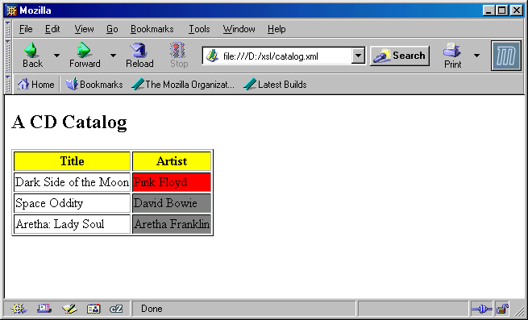

Slide 67
Applying Templates Recursively
The following example shows how to apply templates recursively
Generally, it is possible (but not in this example) that more than one template matches the current source node
The specification (www.w3.org/TR/xslt) describes (Section 5.5) which template should be chosen for application

Slide 68
<?xml version="1.0" encoding="ISO-8859-1"?>
<xsl:stylesheet version="1.0"
xmlns:xsl="http://www.w3.org/1999/XSL/
Transform">
<xsl:template match="/">
<html>
<body>
<h2>A CD Catalog</h2>
<xsl:apply-templates/>
</body>
</html>
</xsl:template>

Slide 69
<xsl:template match="cd">
<p>
<xsl:apply-templates select="title"/>
<xsl:apply-templates select="artist"/>
</p>
</xsl:template>
<xsl:template match="title">
Title: <span style="color:red">
<xsl:value-of select="."/></span>
<br />
</xsl:template>

Slide 70
<xsl:template match="artist">
Artist: <span style="color:green">
<xsl:value-of select="."/></span>
<br />
</xsl:template>
</xsl:stylesheet>

Slide 71
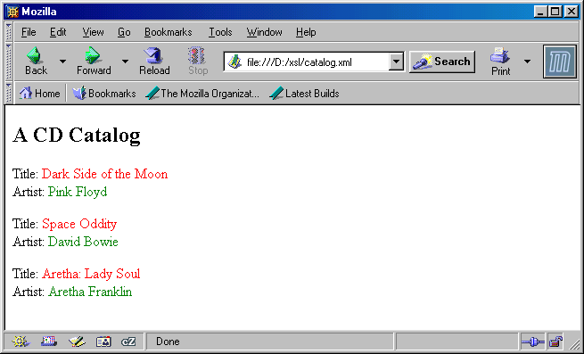

Slide 72
Is Recursive Application of Templates Really Needed?
The output of the previous example can also be generated by an XSL stylesheet that uses only one template that matches the root (and does not use the element <xsl:apply-templates>)
However, some tasks can only be done by applying templates recursively
  This typically happens when the structure of the source XML document is not known

Slide 73
For example
Suppose that we want to write an XSL stylesheet that generates an exact copy of the source XML document
  It is rather easy to do it when the structure of the source XML document is known
Can we write an XSL stylesheet that does it for every possible XML document?
  Yes! (see next slide)

Slide 74
<?xml version="1.0"?>
<xsl:stylesheet xmlns:xsl="http://www.w3.org/1999/XSL/Transform"
version="1.0">
<xsl:output method="xml"/>
<xsl:template match="*">
<xsl:element name="{name(.)}">
<xsl:for-each select="@*">
<xsl:attribute name="{name(.)}">
<xsl:value-of select="."/>
</xsl:attribute>
</xsl:for-each>
<xsl:apply-templates/>
</xsl:element>
</xsl:template>
</xsl:stylesheet>
Identity Transformation
Stylesheet

Slide 75
The <xsl:output> Element
<?xml version="1.0" encoding="ISO-8859-1"?>
<xsl:stylesheet version="1.0"
xmlns:xsl="http://www.w3.org/1999/XSL/
Transform">
<xsl:output method="xml" version="1.0"
encoding="iso-8859-1" indent="yes"/>
......
</xsl:stylesheet>
Tells in what format the output
should be: xml/html/text

Slide 76
Patterns
Thus far we have seen very simple patterns: we simply match against an element name. XSL provides a rich pattern matching capability.
match
document
<xsl:template match=“/”> “When you start processing
the document do ...”
<xsl:template match=“Book”> “When you get to a Book
element do ...”
<xsl:template match=“Title | Author”> “When you get to either
a Title element or an Author
element do ...”
match
by name
match
several
names

Slide 77
Patterns
match
with
immediate
ancestor
<xsl:template match=“Book/Title”> “When you get to a Title
element that has a Book
element as a parent do ...”
<xsl:template match=“BookCatalogue//Title”> “When you get to a
Title element that has a
BookCatalogue as an ancestor
do ...”
<xsl:template match=“Book/*”> “When you get to any element
that is an immediate child of
Book do ....”
<xsl:template match=“id(J.K)”> “When you get to an element
that has an id “J.K.” do ...”
match
with
an
ancestor
wildcard
match
match
by id

Slide 78
Patterns (matching by attribute)
<xsl:template match=“para”> “When you get to a para element
do ...”
<xsl:template match=“para[@type]”> “When you get to a
para element that has an
attribute called type do ...”
<xsl:template match=“para[@type =‘opening’]”> “When you get to
a para element that has an
attribute called type and its value
is ‘opening’ do ...”
<xsl:template match=“chapter[@num=‘ch1’]/para[@type=‘opening’]”>
“When you get to a para element that has an attribute called type whose value is
‘opening’ and the element has a parent called chapter and it has an attribute called
num that has a value ‘ch1’ do ...

Slide 79
Patterns (matching by position)
<xsl:template match=“Book[first-of-type()]”> “When you get to the first Book
element do ...”
<xsl:template match=“Book[last-of-type()]”> “When you get to the last Book
element do ...”
<xsl:template match=“Book[not(last-of-type())]”> “Use this rule for all but the last
Book element”
Other position qualifiers:
not(first-of-type())
first-of-any() “The first child element of any type”
not(first-of-any())
last-of-any()
not(last-of-any())

Slide 80
Named Attribute Sets
XSL allows you to create a set of attributes and assign a name to it.
  What value is this? Reuse!
<xsl:attribute-set name=“title-attributes”>
<xsl:attribute name=“size”>+1</xsl:attribute>
<xsl:attribute name=“color”>red</xsl:attribute>
<xsl:attribute name=“face”>Braggadocio</xsl:attribute>
</xsl:attribute-set>

Slide 81
<?xml version="1.0"?>
<xsl:stylesheet xmlns:xsl=“http://www.w3.org/TR/WD-xsl”
result-ns=“html”>
<xsl:attribute-set name="title-attributes">
<xsl:attribute name=“size”>+1</xsl:attribute>
<xsl:attribute name=“color>red</xsl:attribute>
<xsl:attribute name=“face>Braggadocio</xsl:attribute>
</xsl:attribute-set>
<xsl:template match="BookCatalogue”>
<HTML>
<HEAD>
<TITLE>Book Catalogue</TITLE>
</HEAD>
<BODY>
<TABLE BORDER="1" WIDTH="100%">
<xsl:apply-templates/>
</TABLE>
</BODY>
</HTML>
</xsl:template>
<xsl:template match="Book">
<TR>
<xsl:apply-templates/>
</TR>
</xsl:template>
<xsl:template match="Author | Date | ISBN | Publisher">
<TD>
<xsl:apply-templates/>
</TD>
</xsl:template>
<xsl:template match="Title">
<TD>
<FONT>
<xsl:use attribute-set="title-attributes"/>
<xsl:apply-templates/>
</FONT>
</TD>
</xsl:template>
</xsl:stylesheet>
here’s where
we define the
named attribute
set
here’s where
we use the
named attribute
set

Slide 82
Numbering
XSL has the capability to number your elements
<xsl:number/>.<xsl:apply-templates select="Title"/>
This will print out a number followed by a period
followed by the results of processing the
Title element. The number starts at one and
increments each time this template rule
is instantiated.

Slide 83
Creating a Numbered Title List
<?xml version="1.0"?>
<xsl:stylesheet xmlns:xsl=“http://www.w3.org/TR/WD-xsl”
result-ns=“html”>
<xsl:template match="BookCatalogue">
<HTML>
<HEAD>
<TITLE>Book Catalogue</TITLE>
</HEAD>
<BODY>
<TABLE BORDER="1" WIDTH="100%">
<xsl:apply-templates/>
</TABLE>
</BODY>
</HTML>
</xsl:template>
<xsl:template match="Book">
<xsl:number/>.<xsl:apply-templates select="Title"/><br/>
</xsl:template>
<xsl:template match="Title">
<xsl:apply-templates/>
</xsl:template>
</xsl:stylesheet>
Here’s where
we are using
the number
capability

